Slide 1
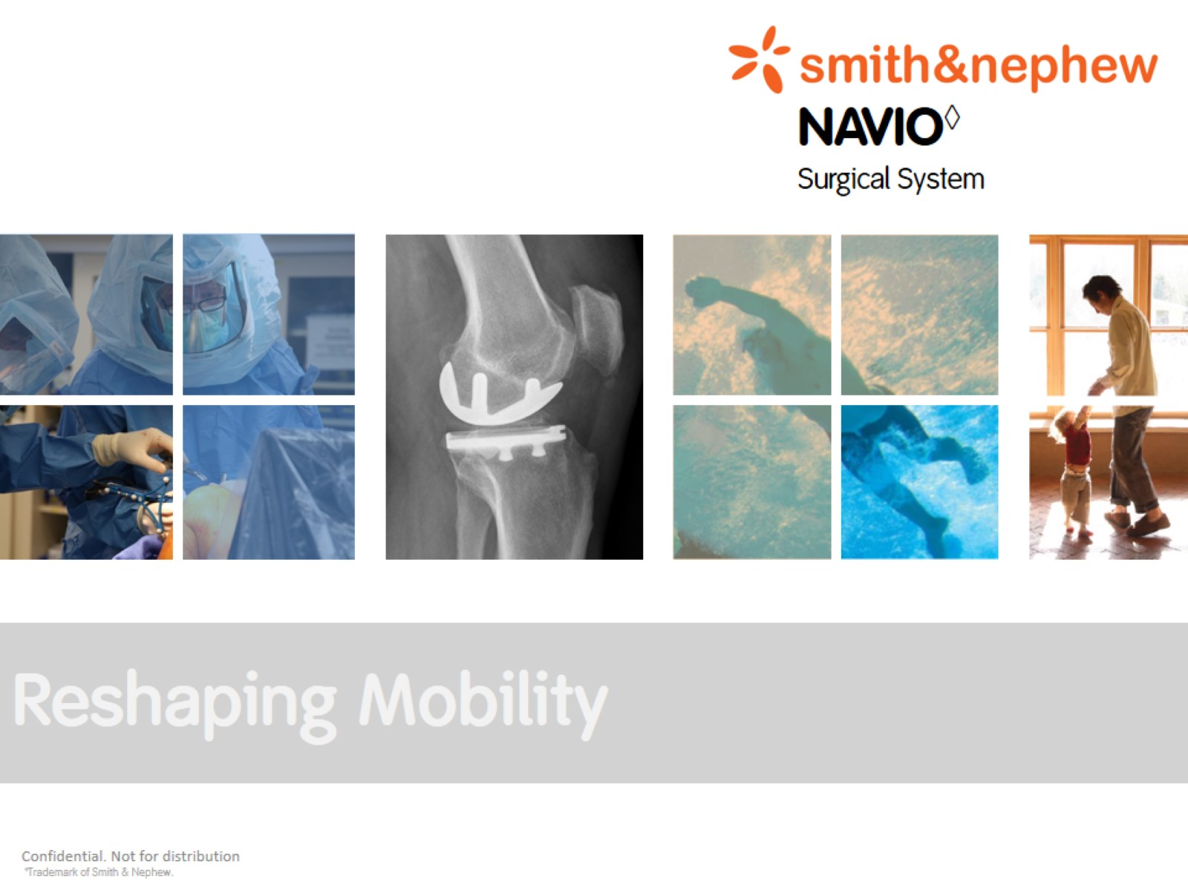

Slide 2
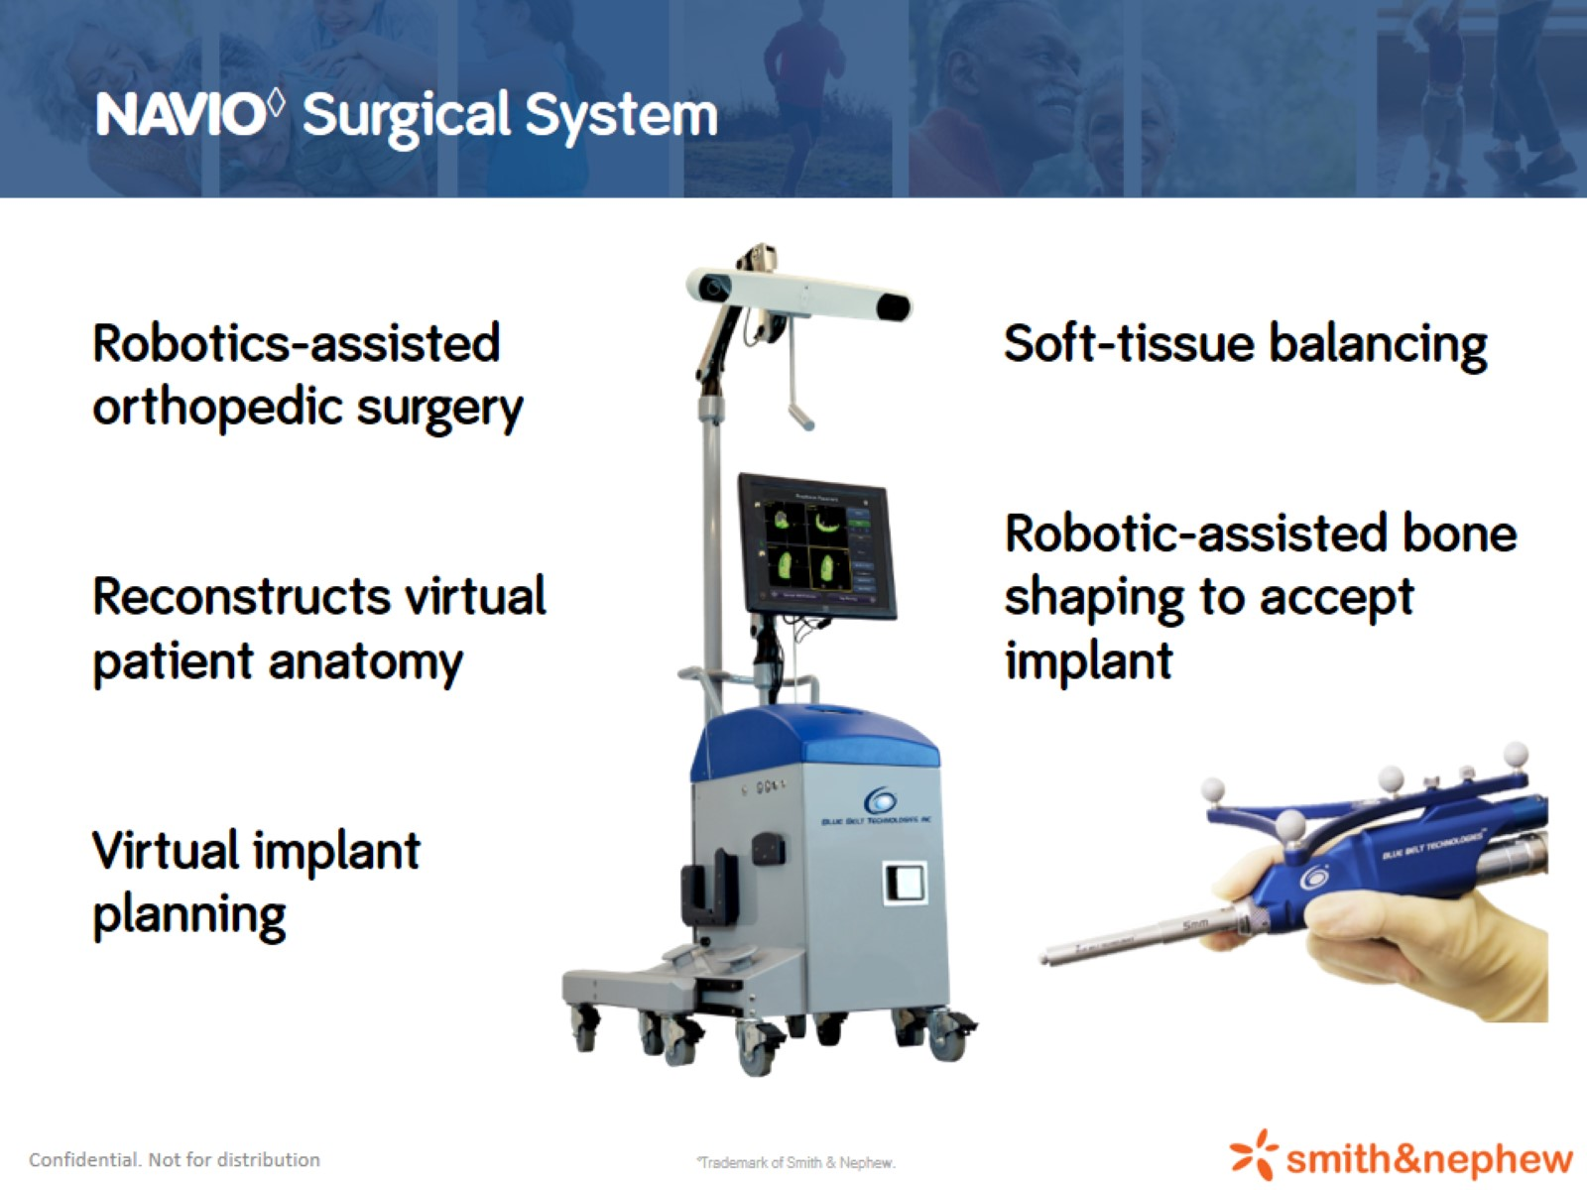
NAVIO◊ Surgical System
Notes:
Overview of the Navio system and what its core features are:
- Robotic Assisted Surgery for Unicompartmental and Patellofemoral joint replacement
- Patient anatomy is virtually reconstructed intraoperatively by registering and mapping the articular anatomy without the need for pre-op imgaging
- Navio software allows components to be virtually planned against the mapped anatomy
- Soft tissue information is input into the software to provide gap balancing analysis
- Robotic-assisted handpiece enables precision bone resection for accurate component placement to match the intraoperative plan

Slide 3
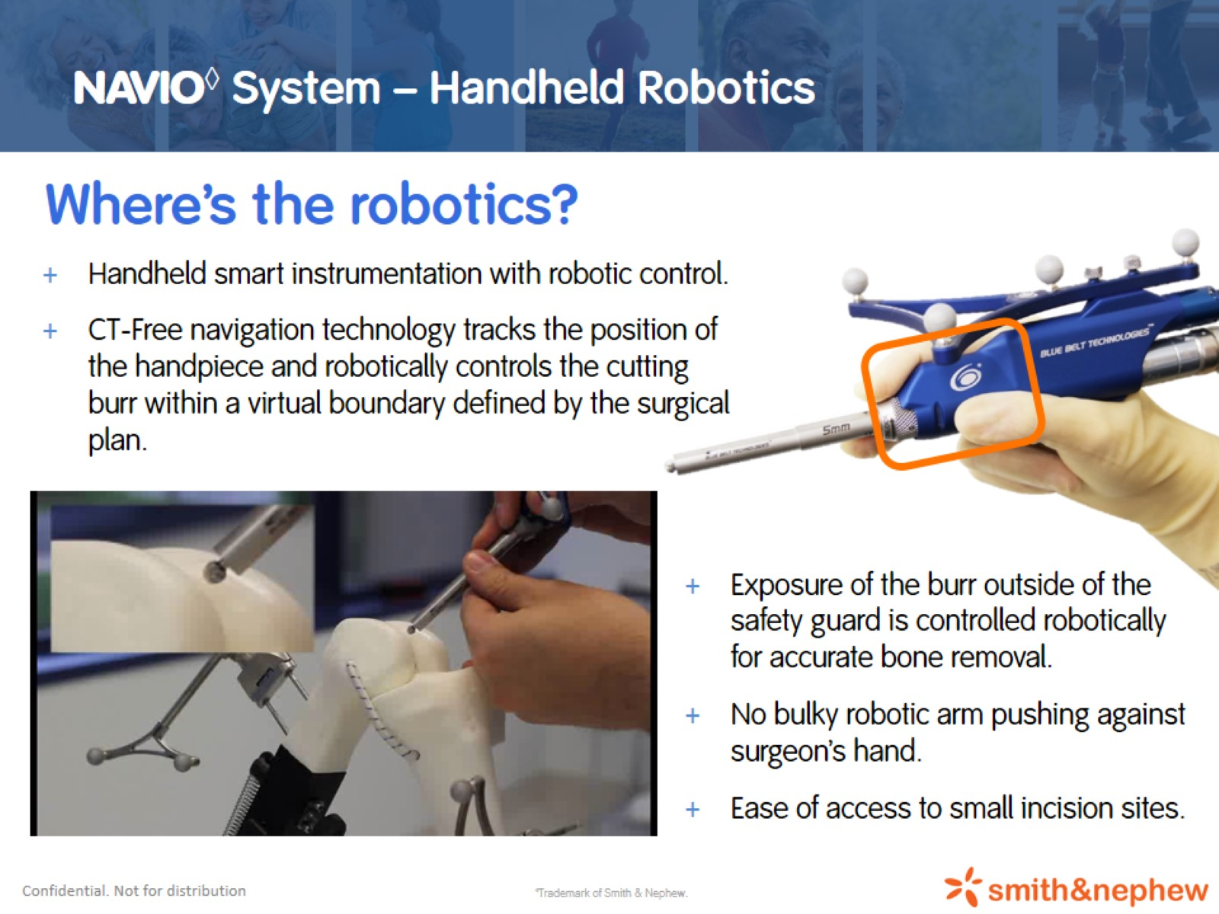
NAVIO◊ System – Handheld Robotics
Notes:
The navio features “handheld robotics”.
Robotic actuator has been scaled down to fit within a handheld smart instrument.
This eliminates the need for bulky industrial style robotic arms (e.g. MAKO) and allows for easier integration into the smallest of operating theatres and hospitals
Handpiece is optically tracked to ensure that it only resects bone within the defined “virtual haptic” zone
Robotic actuator inside the handpiece is computer controlled to adjust the exposure of the burr within the safety guard
Standard incision is required. Small handpiece doesn’t require a larger incision

Slide 4
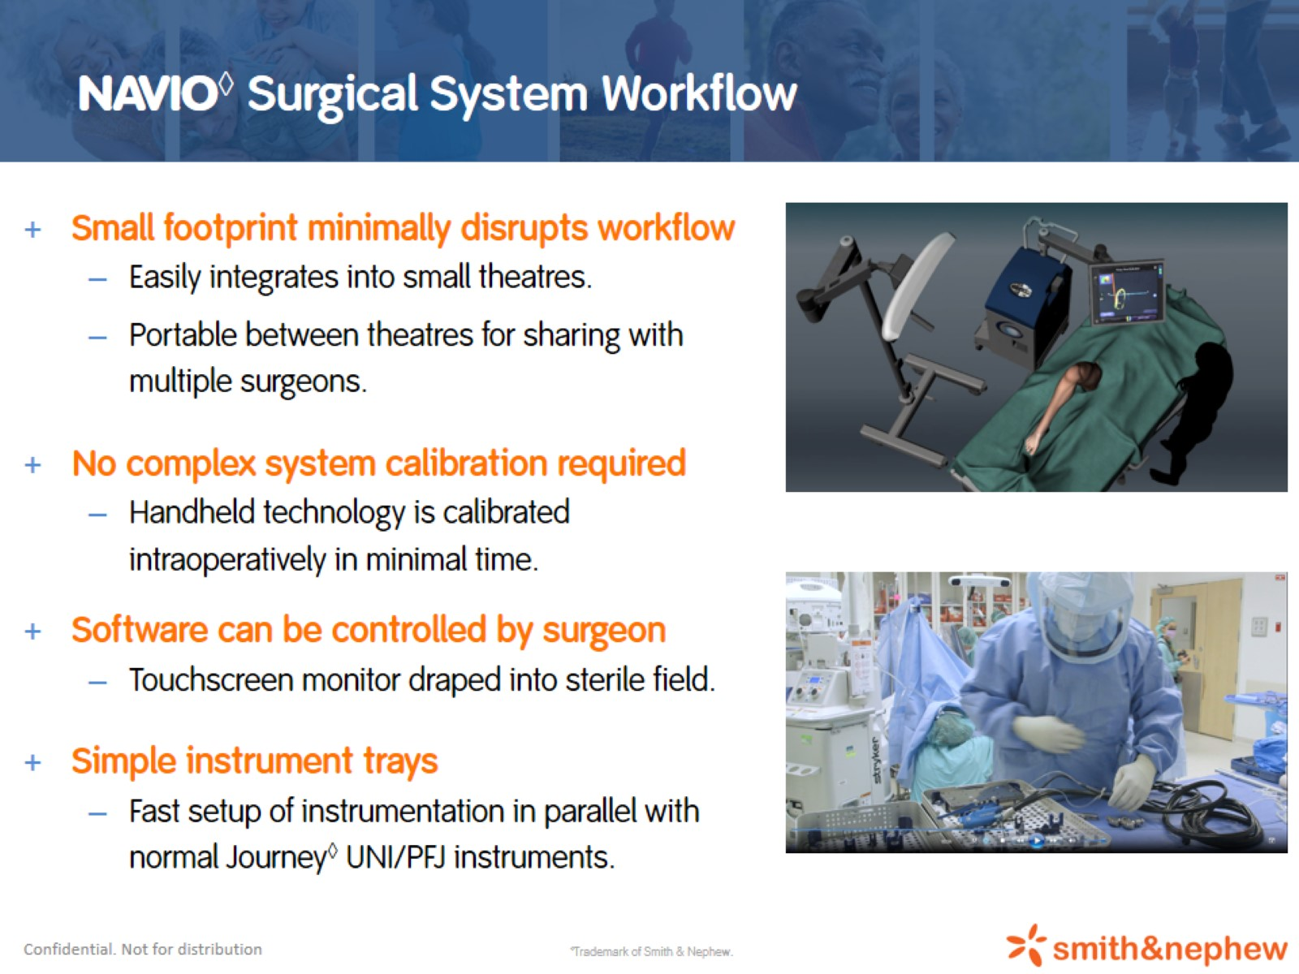
NAVIO◊ Surgical System Workflow
Notes:
Navio system is compact and easily integrates into any operating theatre
No complex calibration means that the system can easily be moved between theatres to allow surgeons to share the use of the system
The software is completely controllable by the surgeon through the foot pedals and sterile touchscreen (sterile draped)
Simple instrumentation means there is no delay to theatre setup time

Slide 5
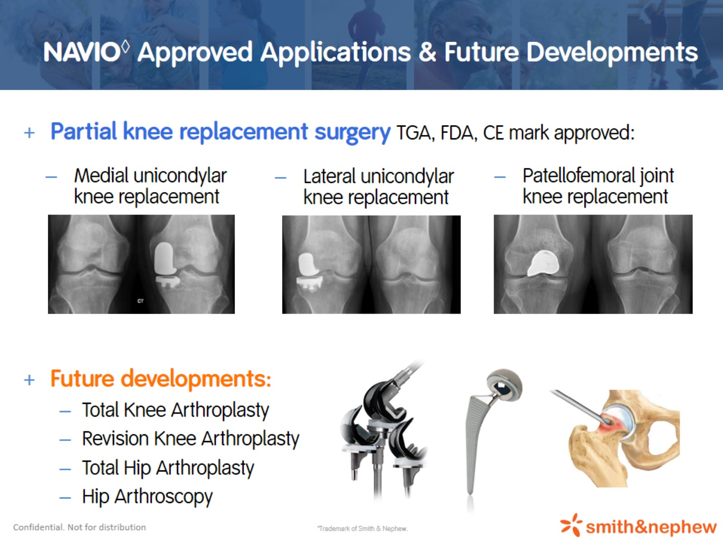
NAVIO◊ Approved Applications & Future Developments
Notes:
Currently approved for use with Uni (medial and lateral) and PFJ
Recently received FDA approval for TKA. Expecting Australian approval for TKA in early 2017
Future developments include revision TKA, THA, Hip arthroscopy and more

Slide 6
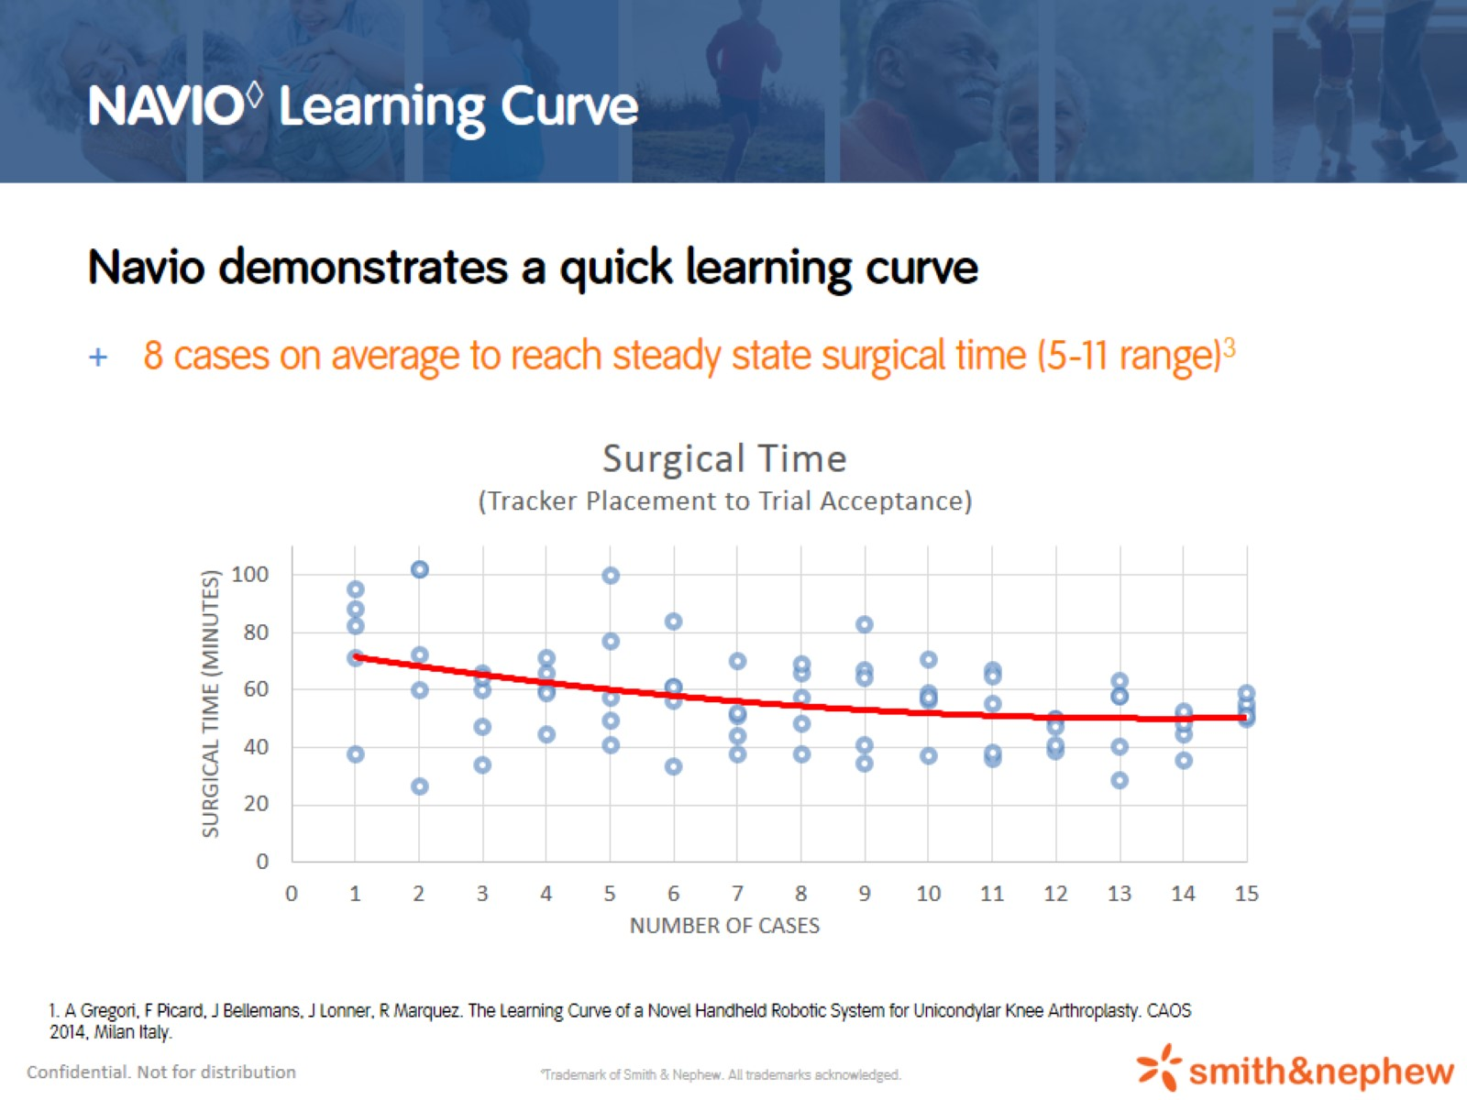
NAVIO◊ Learning Curve
Notes:
Relatively simple learning curve. On average surgeons reach a steady state operating time within 8 cases. Steady state time is usually on par with non-robotic assisted Uni procedure.

Slide 7
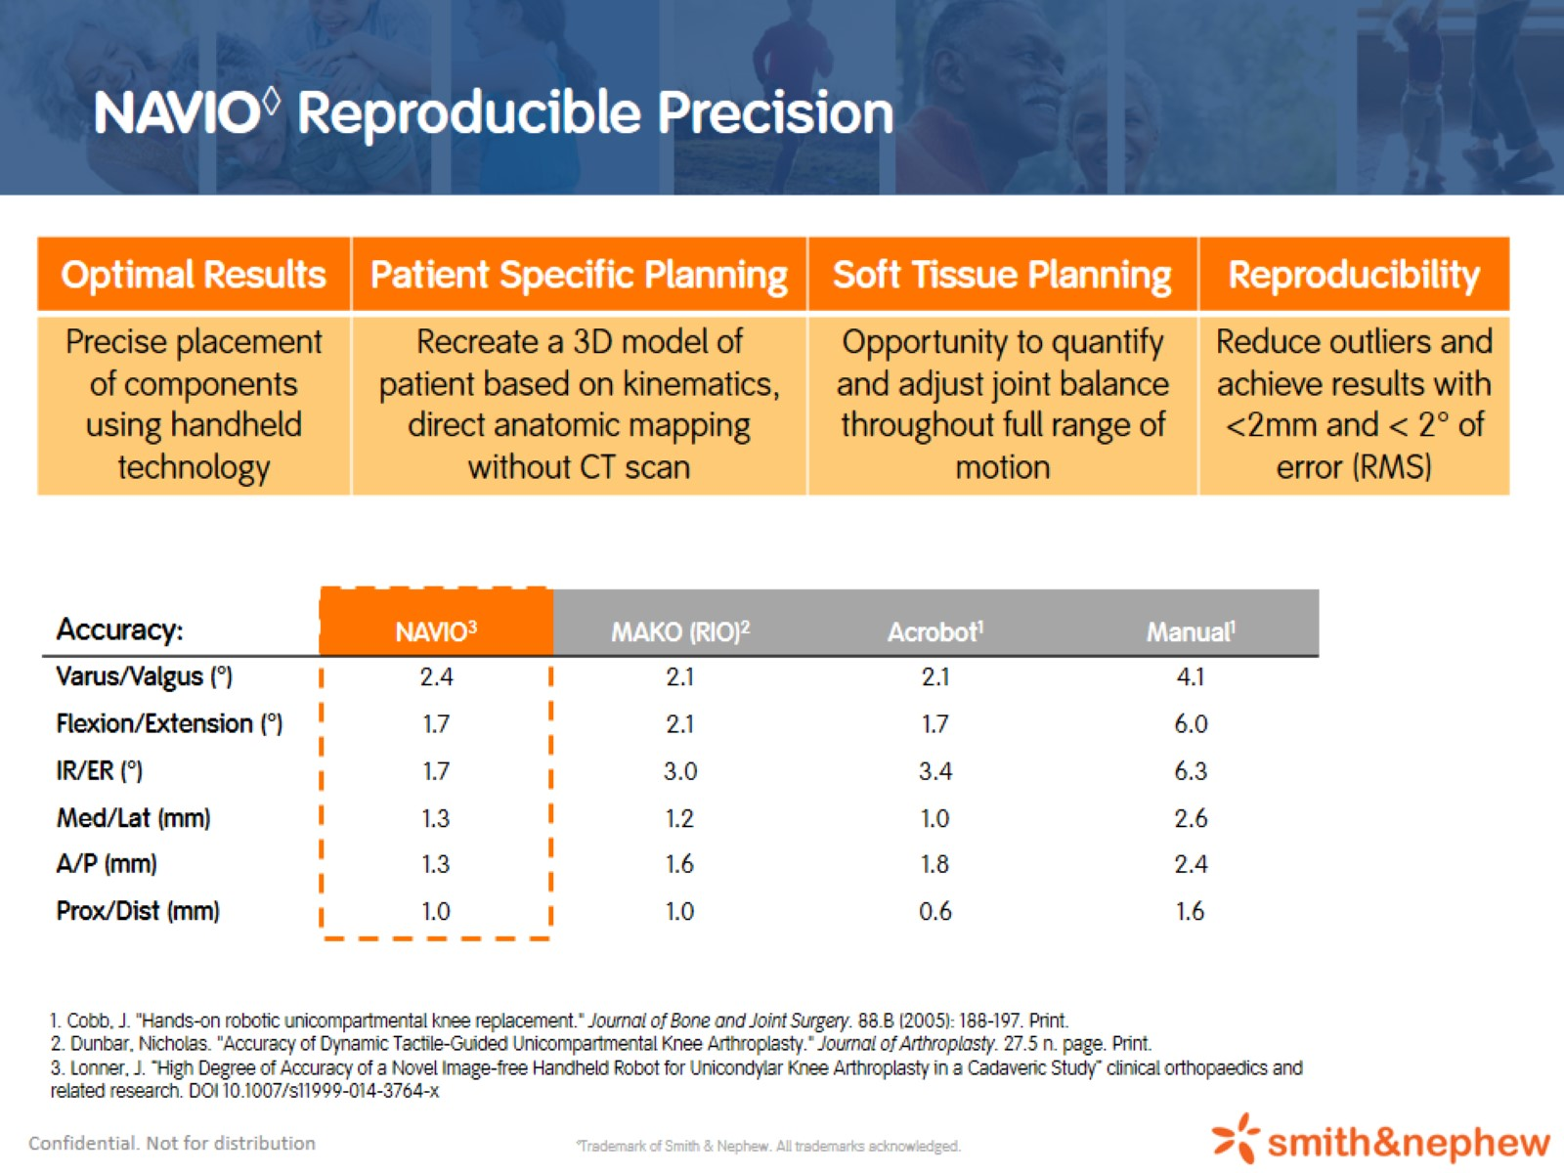
NAVIO◊ Reproducible Precision
Notes:
Accuracy of final component placement versus planned position has been assessed in a published study. Navio accuracy is comparable to other robotic systems (e.g. MAKO) and significantly improved upon non-robotic surgery for Unicompartmental procedures

Slide 8
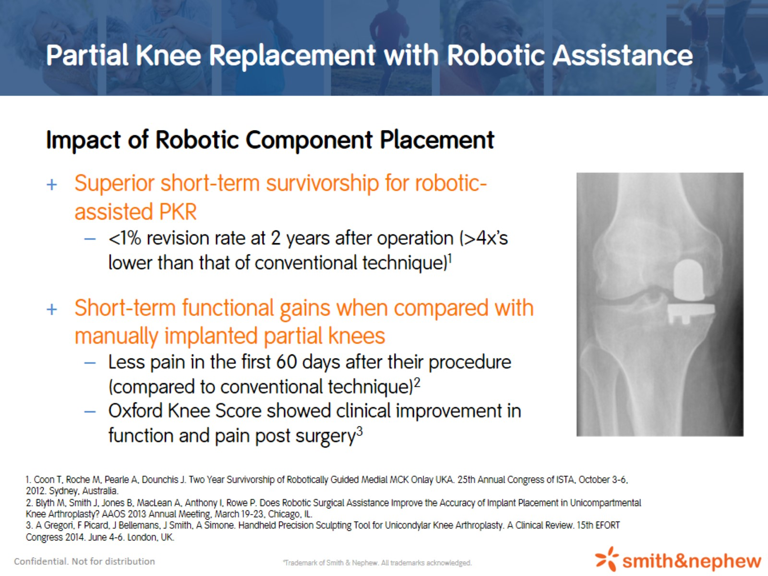
Partial Knee Replacement with Robotic Assistance
Notes:
Some short term studies have found there to be slight improvements in patient outcomes in terms of implant survivorship, pain and function scores. More clinical data is required to properly assess long term benefits of robotic-assisted surgery. Further clinical studies are currently in the process of being implemented to gather more long term patient outcomes clinical data.

Slide 9
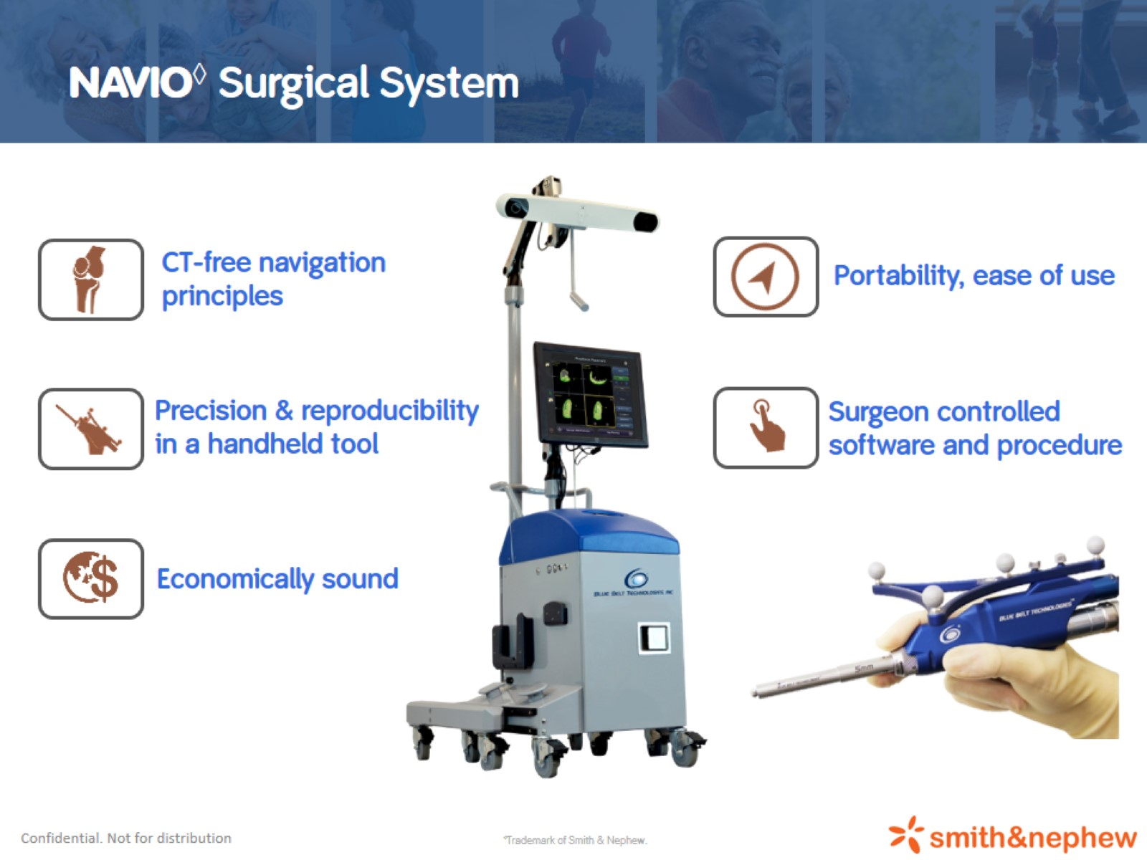
NAVIO◊ Surgical System
Notes:
Main benefits of Navio robotic-assisted surgical system:
- No pre-op imaging required. Anatomy is registered intraoperatively and components are planned intraoperatively.
- Precise resection is enabled through robotic controlled handpiece
- System is compact and portable
- Surgeon maintains control of the software throughout entire procedure.
- System is more economical compared with competitor systems.

Slide 10
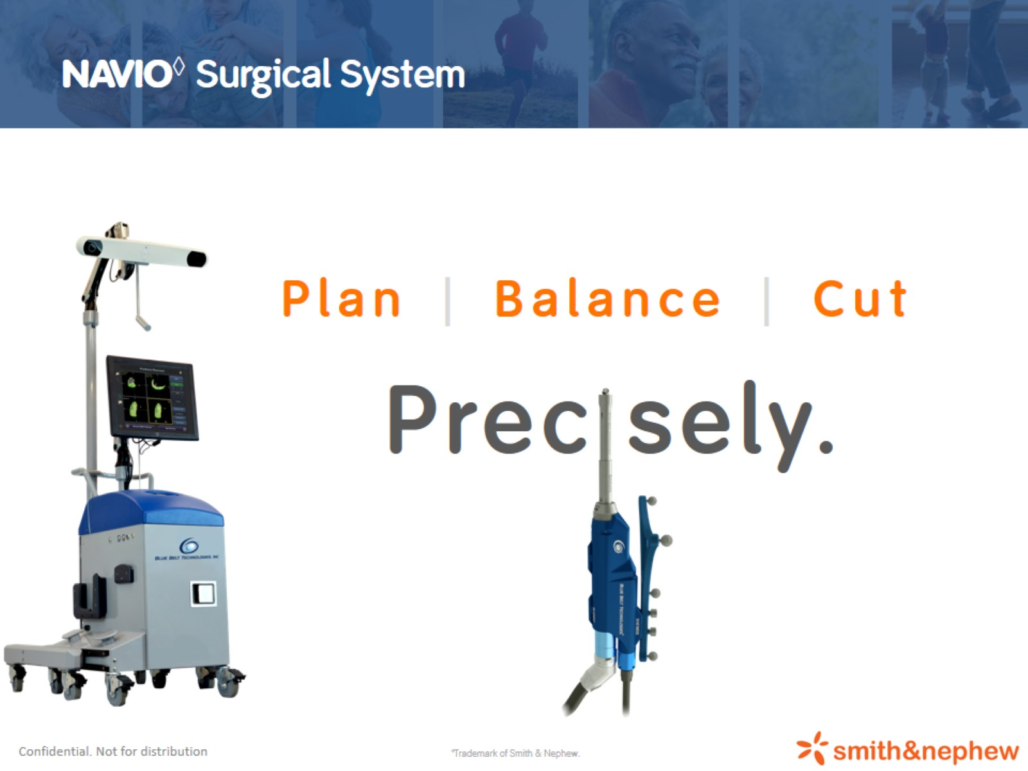
NAVIO◊ Surgical System

Slide 11
